Slide 1


Candia Conservation Commission
Tuesday, January 17, 2012
Public Informational Hearing
The Water Supply
Protection Grant

Slide 2
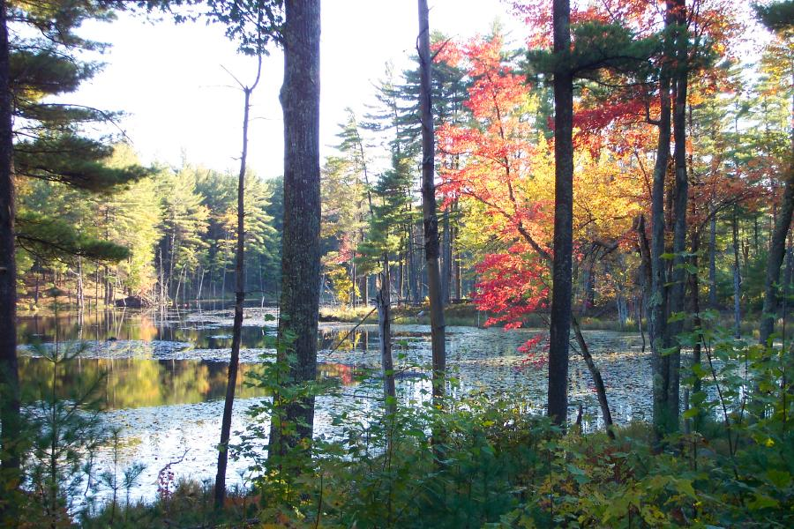
The Candia Conservation Commission’s mission is to protect the town’s natural resources.
These resources include water, soil, forests, wetlands, streams, and wildlife habitat.

Slide 3
Federal Funds
(Water Supply Protection Program) money is available to towns to help them protect their natural resources due to the pressures and impact of the expansion and development of I-93.

Slide 4
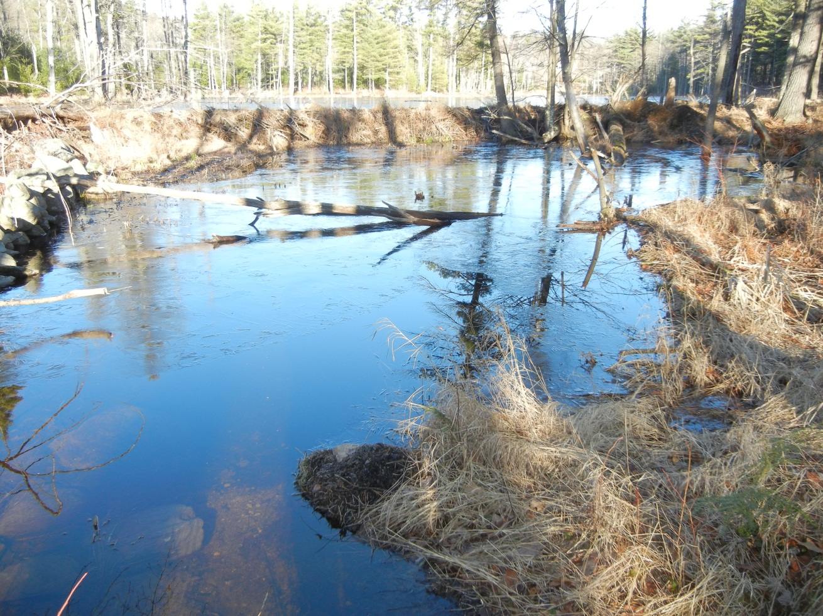
This grant money can be used by NH DES to protect water supplies!
( Insert water scene photo here)
At no additional cost to our Taxpayers!

Slide 6
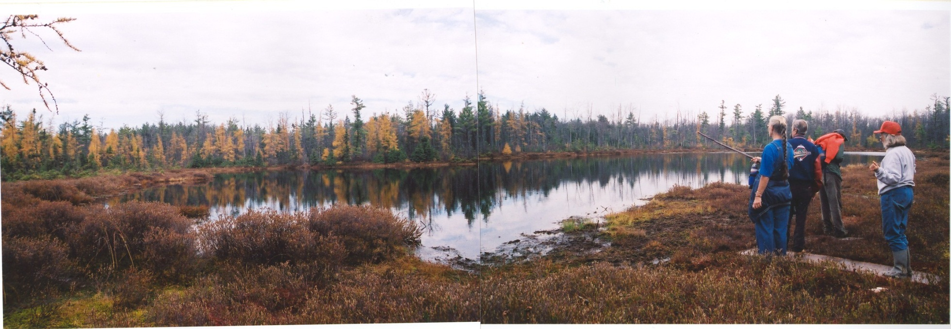
Candia wants to apply for the money to purchase & protect two pieces of land in the Massabesic Watershed.
These are located near the Kinnicum Pond.

Slide 7
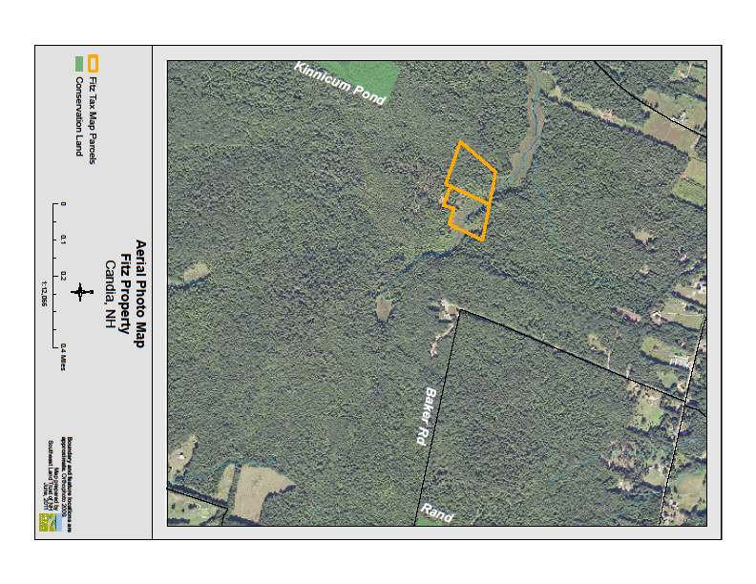

Slide 8
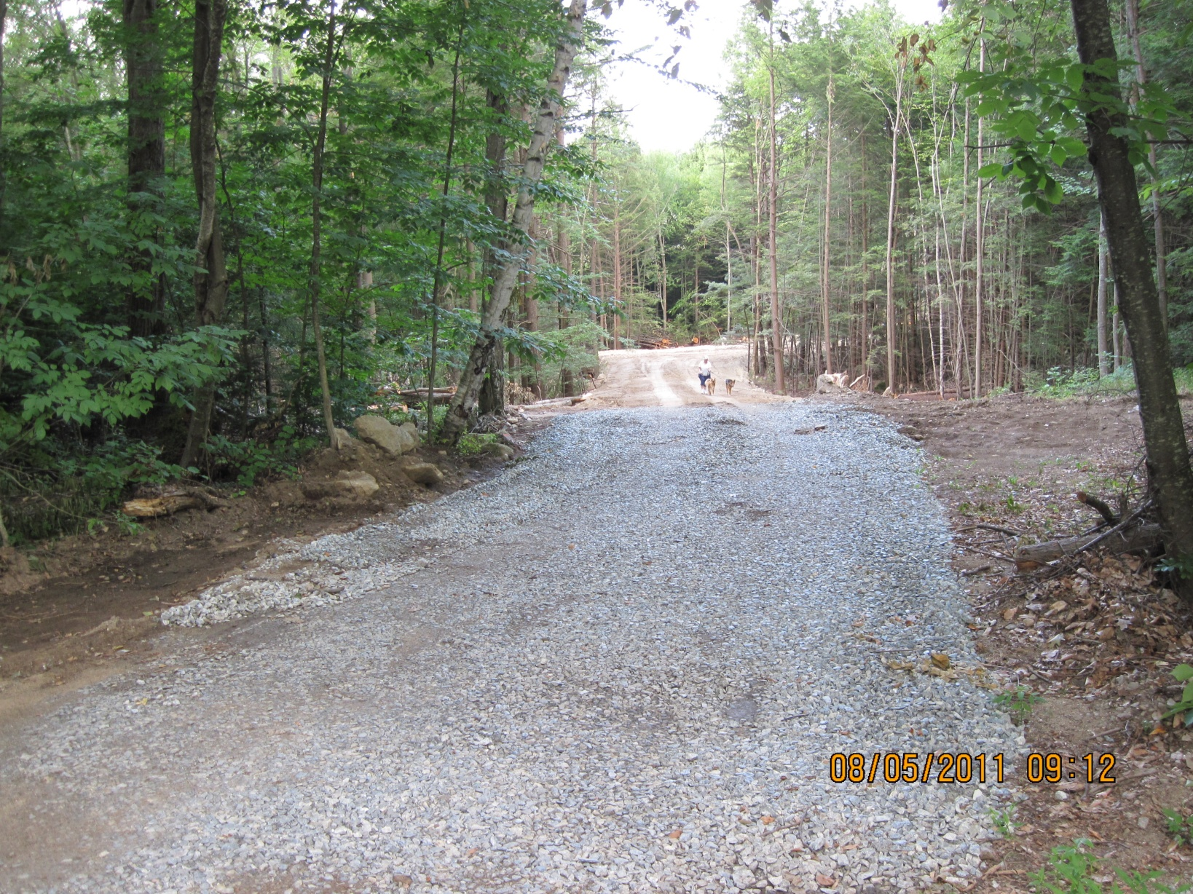
The Hemlock Drive Town Forest property, also located within the Massabesic Watershed, will then also be protected with a conservation easement.

Slide 9
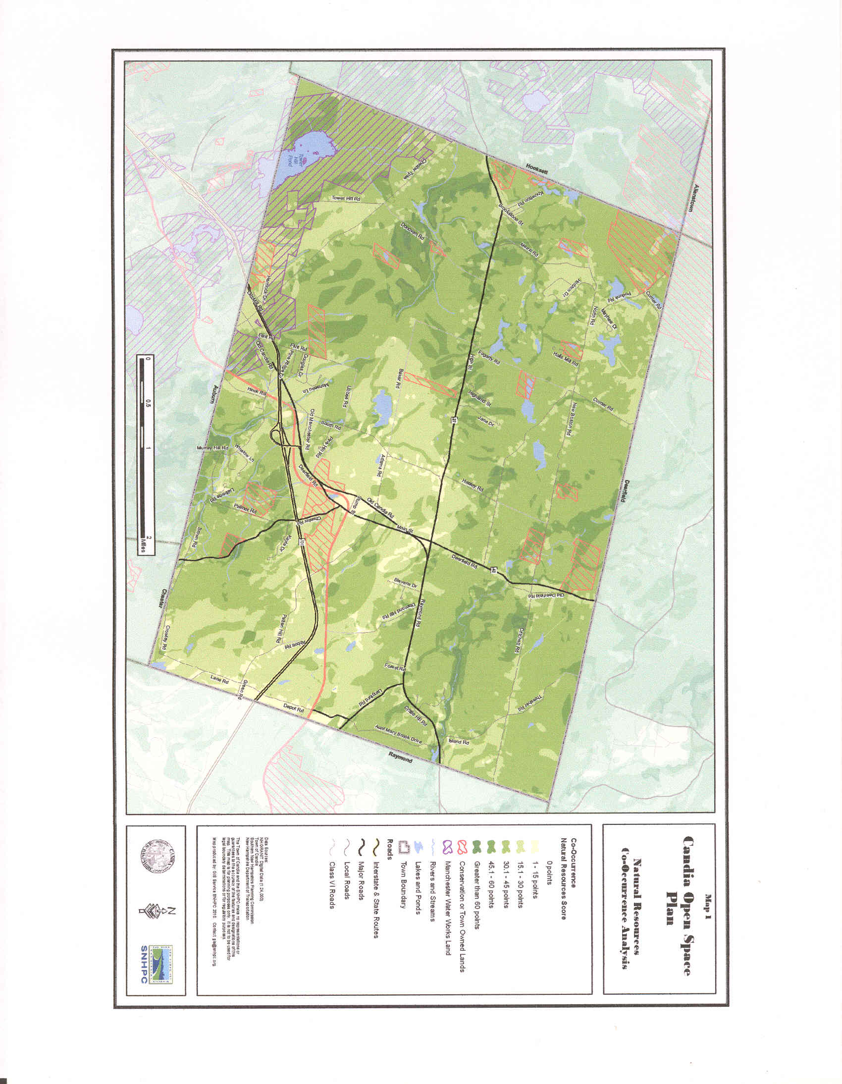

Slide 10

All land has value.
When a piece of property is appraised for development, it has a certain value.
When that same piece of property is appraised without the development rights, it has another lower value.
The difference between these two appraisals is the $worth of the development rights.
This $worth can be applied as our match for the grant.
Thus we can protect our water supply with these transferred values.

Slide 11
Applying for this grant accomplishes
two things:
We protect more of our watershed by adding two abutting properties that are located within this watershed.
We add a protective conservation easement on our Town Forest, also located within the watershed, so it can continue to protect our water supplies for us, our children and future generations.

Slide 12

The CCC is submitting a warrant article which would allow the CCC to:
apply for
accept and
administer this watershed grant.

Slide 13
Here is the actual wording of the warrant article.
To see if the Town will vote to authorize the Candia Conservation Commission to apply for, accept and administer a Water Supply Protection Grant from the New Hampshire Department of Environmental Services that will allow for the purchase and permanent protection, thru a conservation easement, of two abutting parcels of undeveloped land (Map 410 Lots 100 & 101) in the Massabesic Watershed and further, to authorize the permanent protection, thru a conservation easement, of the Hemlock Drive Town Forest property (Map 412 Lots 3 & 4) in the Massabesic Watershed, using the value of the development rights of the Hemlock Drive Town Forest property as the necessary monetary match for the Water Supply Protection grant, resulting in the permanent protection of approximately 80 acres of open space land in the Massabesic Watershed at no additional cost to the taxpayers.

Slide 14
This is a perfect balance of using
grant money to protect
our town’s water supply!
This land is already located in this critical watershed area.
It expands the area being protected. It enlarges the protected areas within an already fragmented piece of land.
In the process, it guarantees more open space for the citizens of Candia to enjoy! A forested area to hike, walk your dog, snowshoe, hunt, bird watch, explore and more.
It can also bring in tax revenues through forestry and logging operations.

Slide 15
Please support this warrant article at our Town Meeting. By doing so, you help:
ensure clean, safe drinking water for us and our neighbors.
protect valuable wildlife habitat and open space and our neighborhoods.
maintain what the people of Candia truly love about this town – the rural character and charm of forests, fields and nature.

Slide 16
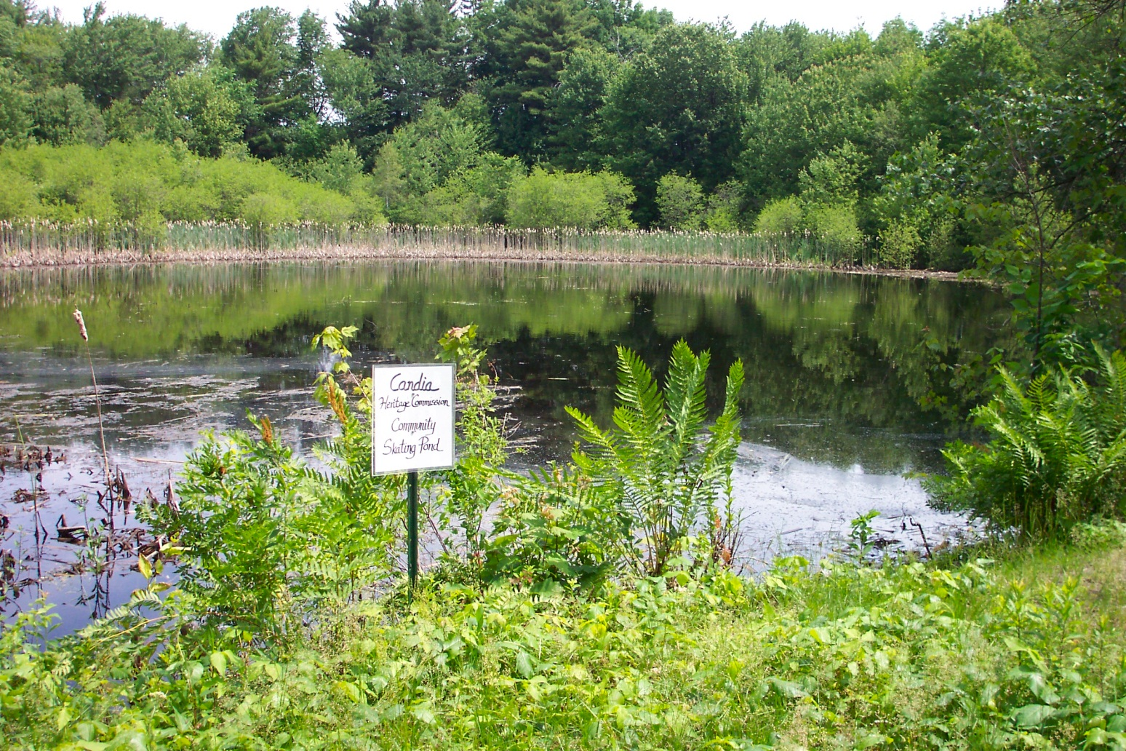
Candia’s value for us
is in its natural resources.

